Slide 1
INN Hotels Booking Cancellation Prediction
PGP-DSBA _ INN Hotels Project
December 15, 2023

Slide 2
Contents / Agenda
Executive Summary
Business Problem Overview and Solution Approach
EDA Results
Data Preprocessing
Model Performance Summary
Appendix

Slide 3
Executive Summary (1/3): Conclusions on the Logistic Models
A predictive logistic model has been built that permits the INN Hotel Management to determine, with an f1_score of 0.70 on the training set, whether a given client will cancel their booking or not and, thus, better inform management of bookings
Among the three models assessed, on both the training and test data sets, the model with default threshold was the most accurate while the model with a threshold of 0.37 had the highest f1 score
Increase in parking space requested, month of arrival (from January to December), and number of special requests tends to reduce the likelihood of a client cancelling their booking
The likelihood of cancellation is increased by increase in the number of people (adults and children) involved, the number of days booked, and the lead time

Slide 4
Executive Summary (2/3): Conclusions on the Tree Classifier Models
A predictive model has been built that permits the Hotel Management to determine, with an f1 score of 0.99 on the training set, the likelihood of a client cancelling their booking
Among the three models assessed: On the training data set, the untuned model was the most accurate and had the highest f1 score; On the test data set, the untuned model was the most accurate whereas the post-tuned model had the highest f1 score
We observed, from the decision tree, that when the lead time is between than 150 and 163 days, the average price per room is less than 100 euros, there are no special requests, and the market segment type is not online, then bookings made after May will most likely be cancelled

Slide 5
Executive Summary (3/3): General Conclusions and Recommendations
Clearly, the tree classifier performs much better than the logistic regressor
The Hotel Management should pay attention to the number of people, the number of days booked, the lead time, the average price per room, the number of special requests, the market segment type, and the month of arrival since these are important parameters that determine the likelihood of a client cancelling their bookings
Management should consider exploring several other parameters that may help provide a better prediction of the likelihood of a client cancelling their booking
On the part of the data science team, we will consider testing several other models and hyper parameter tuning in an effort to improve prediction performance

Slide 6
Business Problem Overview
INN Hotels Group registered a significantly high number of reservation cancellations within its chain of hotels in Portugal
In order to better manage registered bookings, my services, as a data scientist, was requested to analyze provided data on a number of bookings and help predict likelihood of any given booking to be cancelled
My task consisted of building a predictive model that will help determine, with a satisfactory level of probability, the cancellation status of bookings made and help establish cost-effective policies for cancellations and refunds

Slide 7
Solution Approach
The following steps were taken to accomplish the above-stated task:
An exploratory data analysis was carried out on the data provided to uncover pre-modelling patterns
Logistic regression models were then built with different probability thresholds and their performances compared
Next, untuned, pre-tuned, and post-tuned tree classification models were built and their respective performances also compared
Finally, the performances of the logistic regression and tree classification models were compared and general conclusions on some significant parameters established

Slide 8
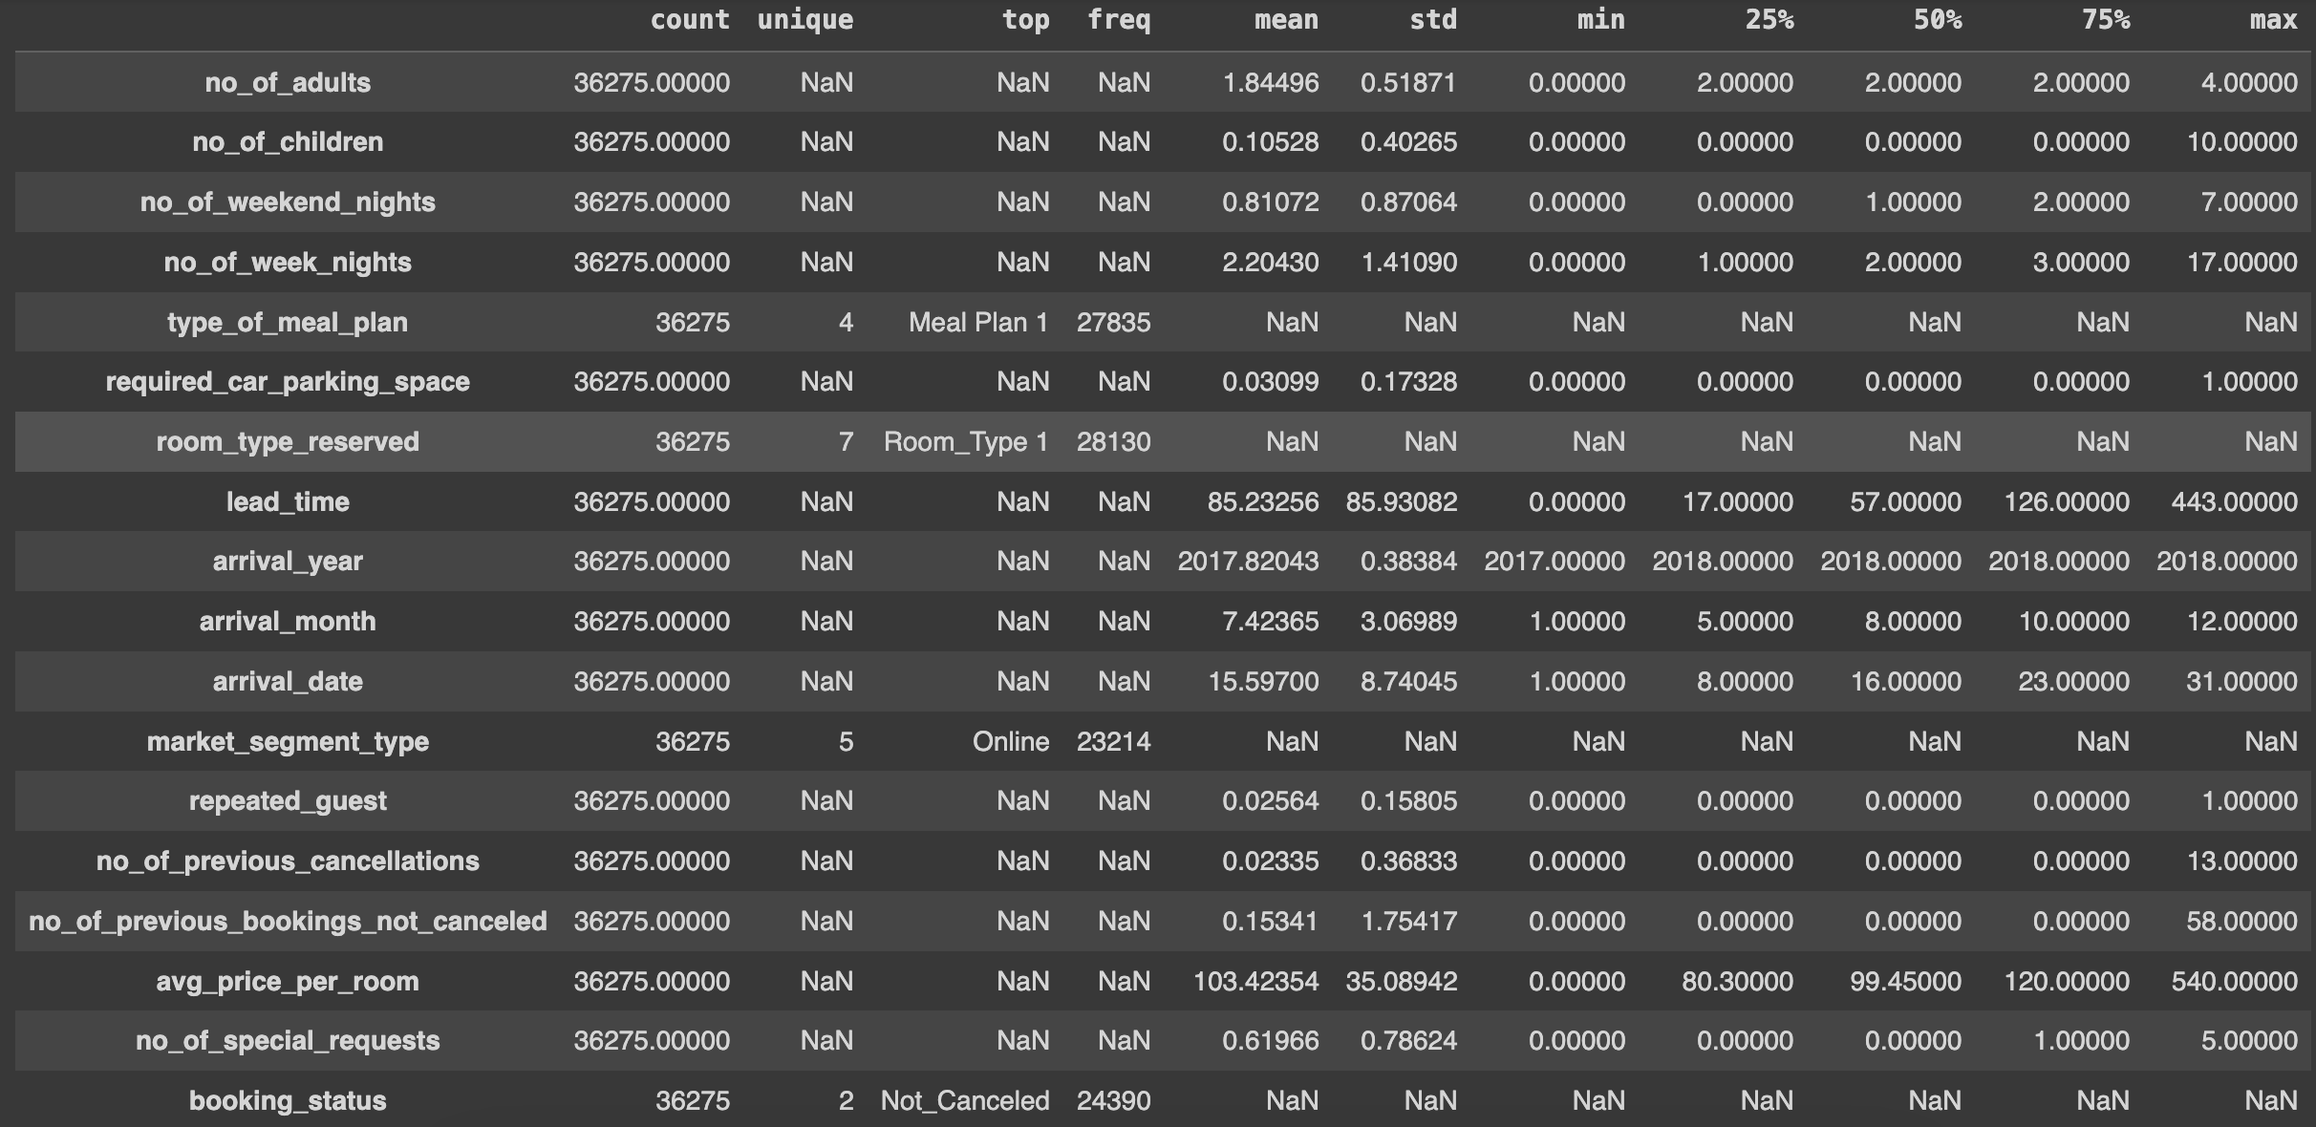
EDA Results: Statistical Summary of the Data
On average, about 2 adults are registered per booking suggesting that most of the bookings are made by couples
More than 3/4 of the bookings register no children though some have had up to 10 children; it might be interesting exploring the details of bookings registering such large amount of children
3/4 of bookings register at most 2 weekend nights and 3 week nights; the maximum numbers of weekend and week nights being 7 and 17 respectively suggests that some bookings might be non-contiguous
Most bookings register only breakfast as meal plan
Most bookings include no request for car parking space
Room_Type 1 is the most booked room type
On average, rooms are booked 85 days before arrival; it might be interesting to explore bookings made over a year before arrival (443 days)
The bookings were registered for arrivals in the years 2017 and 2018; and possibly every month and every day of the month
Most bookings were made online and by new clients
Most of the clients had never cancelled their bookings before; it might be interesting investigating previous cancellations as high as 13 and those having previous bookings as high as 58 - some client qualification and customer loyalty insights might be uncovered
Room prices range between 0 and 540 Euros; interesting exploring cases of unusually low prices or rooms give for free; Might they be cases of loyalty offers, humanitarian gestures by the Chain Hotel Group, etc. ?
Most clients made at most one special request
Close to 70% of the bookings were not cancelled
Link to Appendix slide on data background check

Slide 9
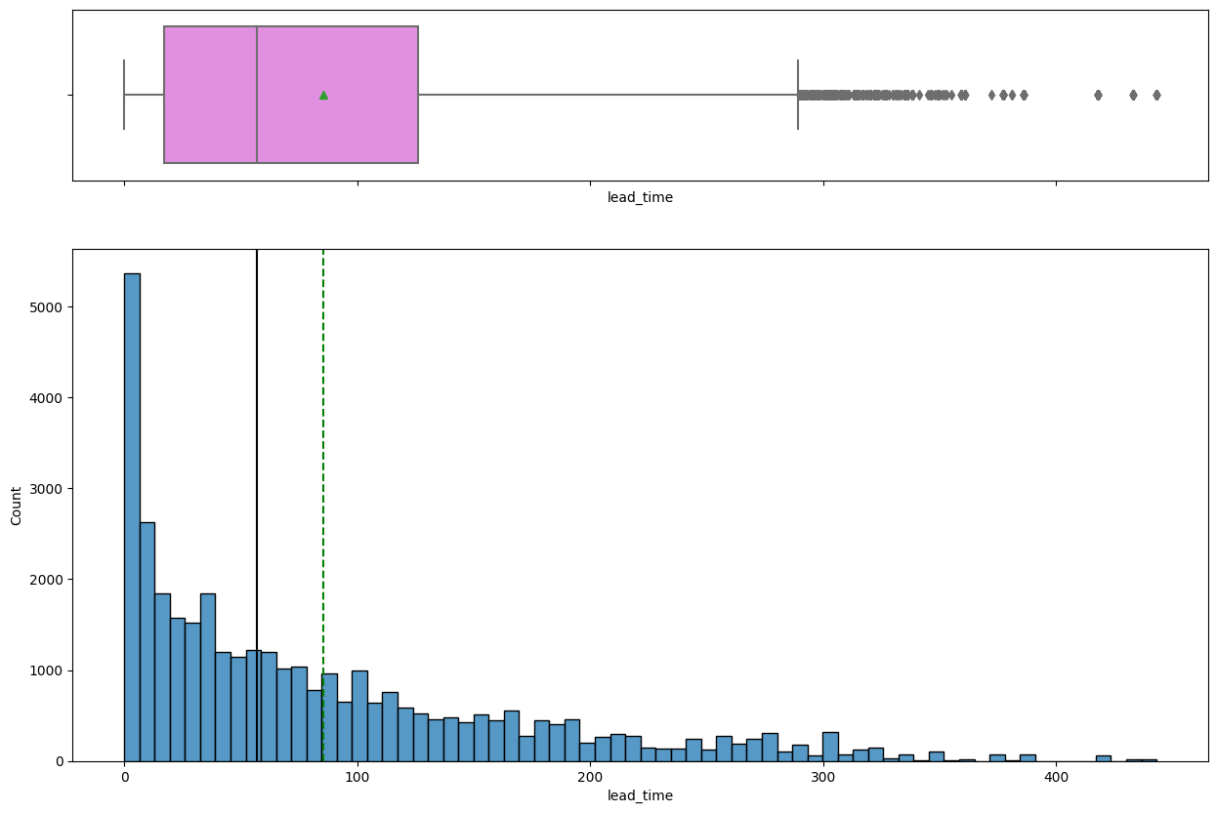
EDA Results: Univariate Analysis: Lead Time
The lead time is right-skewed with several upper outliers
The median and mean are approximately 60 and 80 days respectively
Link to Appendix slide on data background check

Slide 10
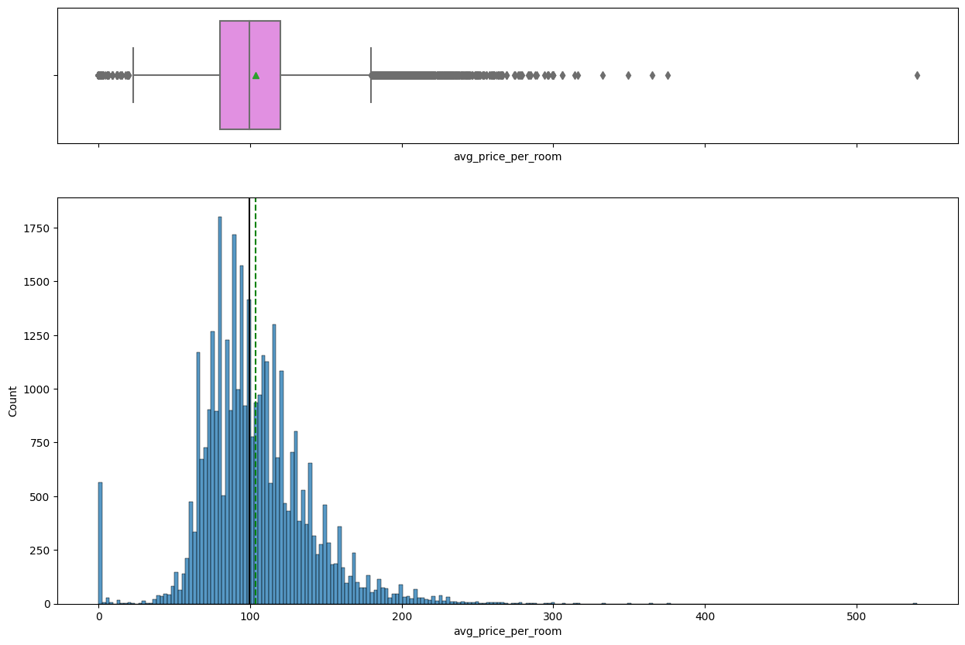
EDA Results: Univariate Analysis: Price Per Room
The average price per room is right-skewed with several outliers on both side of the distribution; a significant number (over 500) of free or very low-priced bookings
The distribution is quasi-normal for the most part and the median is about 100 euros, slightly lower than the average
Link to Appendix slide on data background check

Slide 11
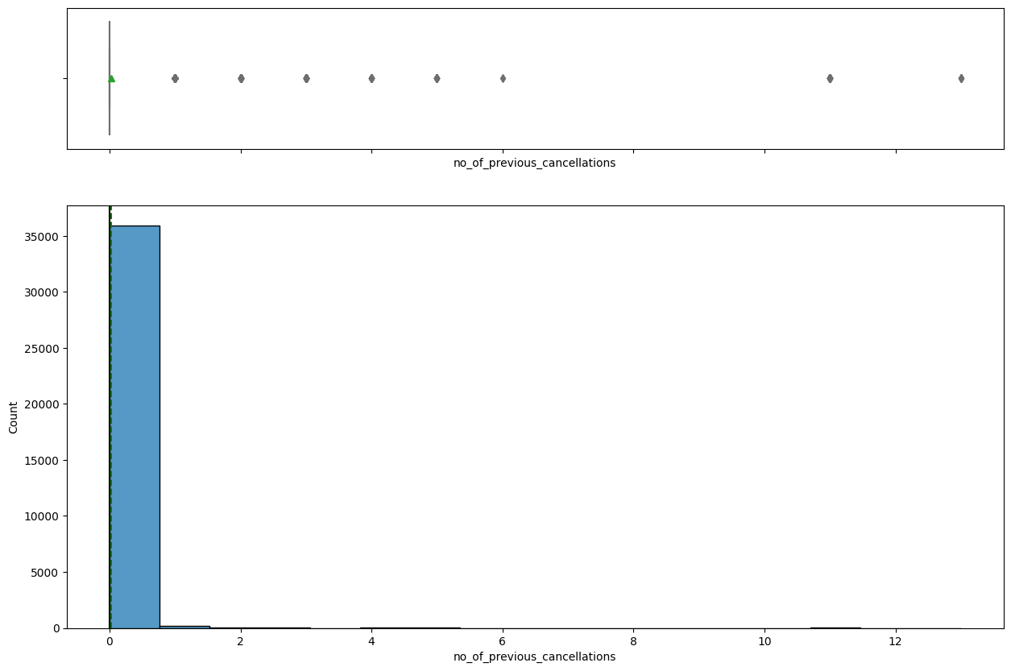
EDA Results: Univariate Analysis: Previous Booking Cancellations
Almost all the clients surveyed had little or no previous cancellations
The number of previous cancellations is right-skewed
Link to Appendix slide on data background check

Slide 12
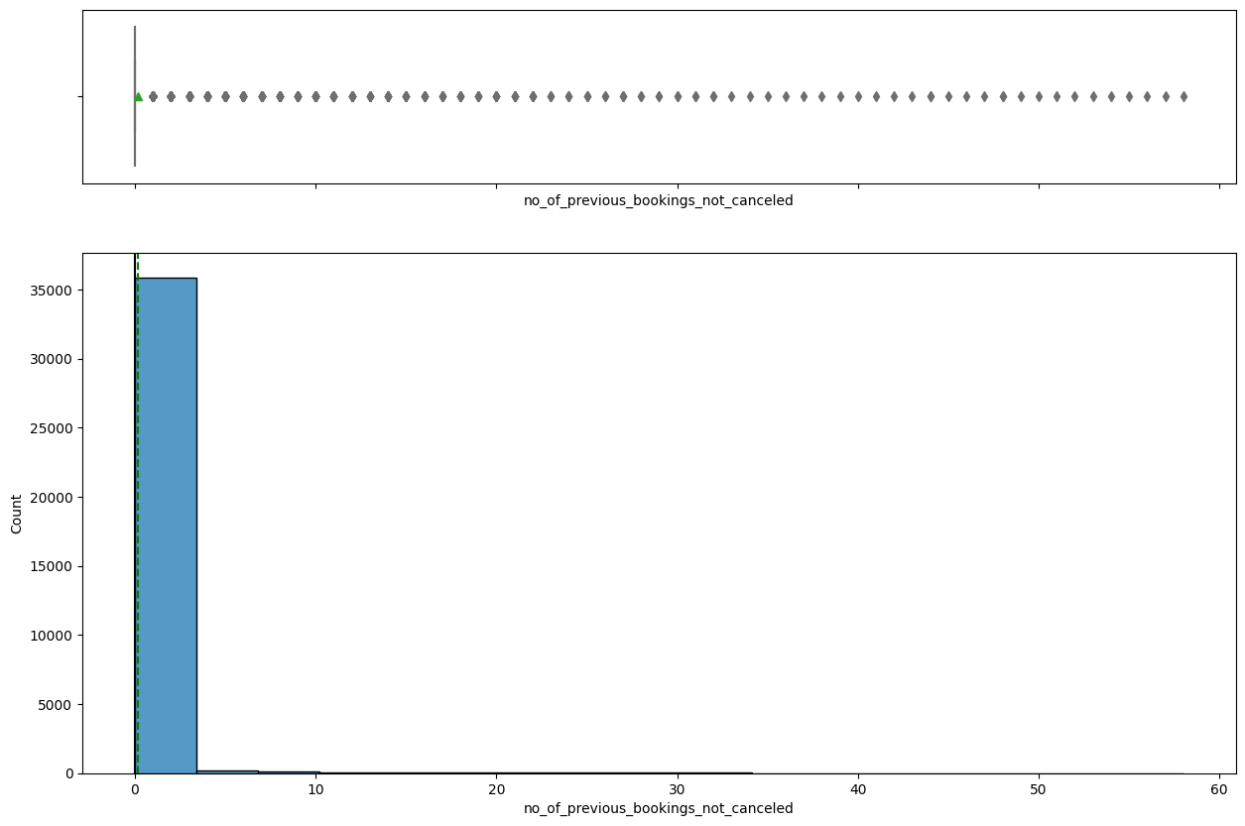
EDA Results: Univariate Analysis: Previous Booking Not Cancelled
The large majority of clients also have little or no previous bookings not cancelled, indicating that most of the bookings were made by new clients
The number of previous bookings not cancelled is also right-skewed
Link to Appendix slide on data background check

Slide 13
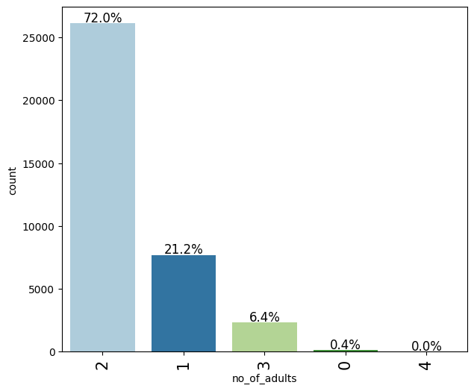
EDA Results: Univariate Analysis: Number of Adults
We have confirmation that the majority (72%) of bookings were made by adult couples
For about 21% of the bookings, single occupants were declared
A very small percentage (0.4%) of the bookings were made by non-adults (logically children) and a much smaller percentage registered 4 adults per booking
Link to Appendix slide on data background check

Slide 14
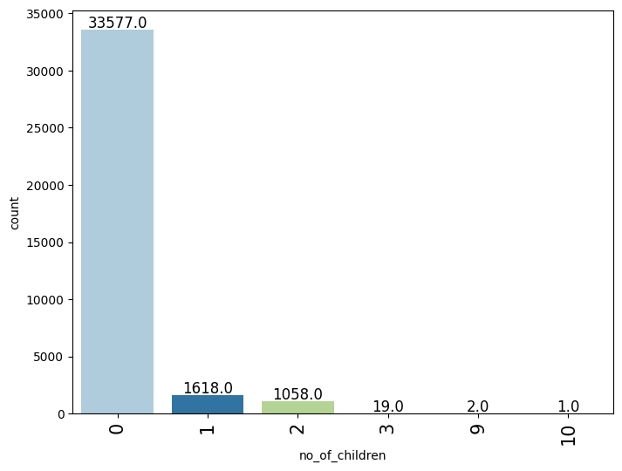
EDA Results: Univariate Analysis: Number of Children
About 93% of the bookings registered no children
3 bookings (Close to 0%) registered 9 to 10 children
Link to Appendix slide on data background check

Slide 15
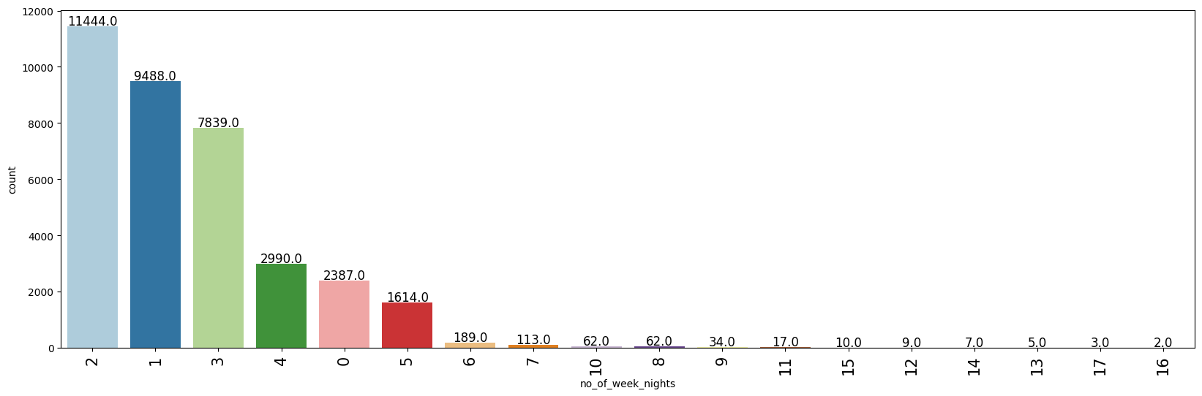
EDA Results: Univariate Analysis: Number of Week Nights
The greatest (32%) of week nights registered per booking is 2, followed by 1 (26%), suggesting that most of the bookings were made for short stays
About 0% of the bookings registered above 10 week nights
Link to Appendix slide on data background check

Slide 16
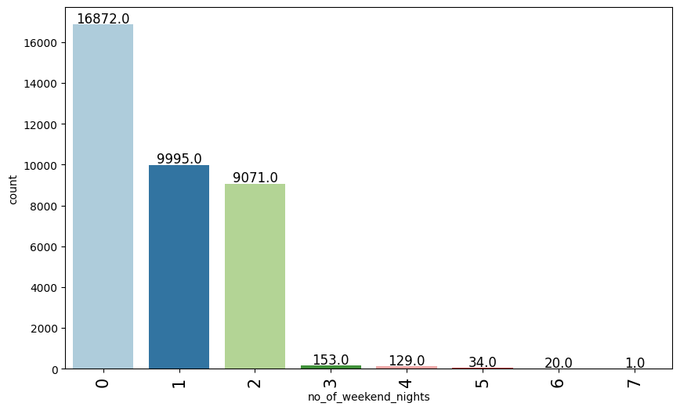
EDA Results: Univariate Analysis: Number of Weekend Nights
Approximately 47% of the bookings included no weekend nights, 28% 1, and 25% 2 weekend nights
The remaining less than 1% of bookings registered 3 to 7 weekend nights
Link to Appendix slide on data background check

Slide 17
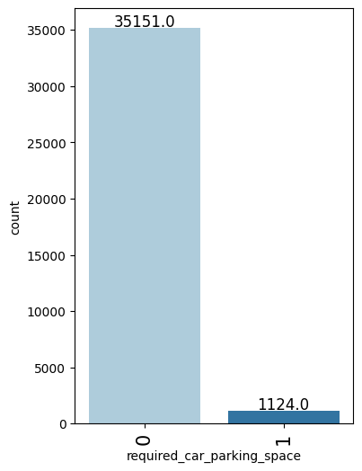
EDA Results: Univariate Analysis: Required Car Parking Space
97% of bookings were made by clients who required no car parking space and no client required more than 1 car parking space
Link to Appendix slide on data background check

Slide 18
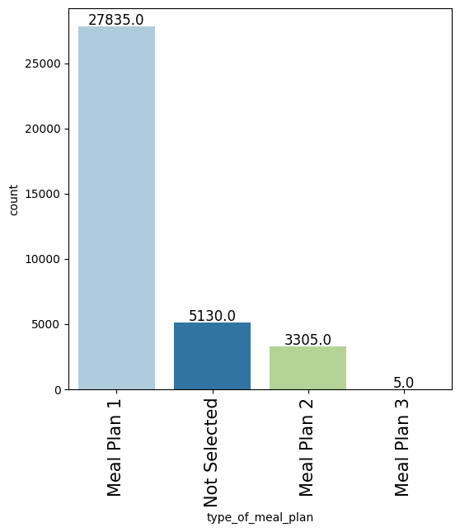
EDA Results: Univariate Analysis: Type of Meal Plan
77% of the bookings were made by clients who chose breakfast only as meal plan
14% selected no meal plan and close to 0% opted for breakfast, lunch, and dinner
Link to Appendix slide on data background check

Slide 19
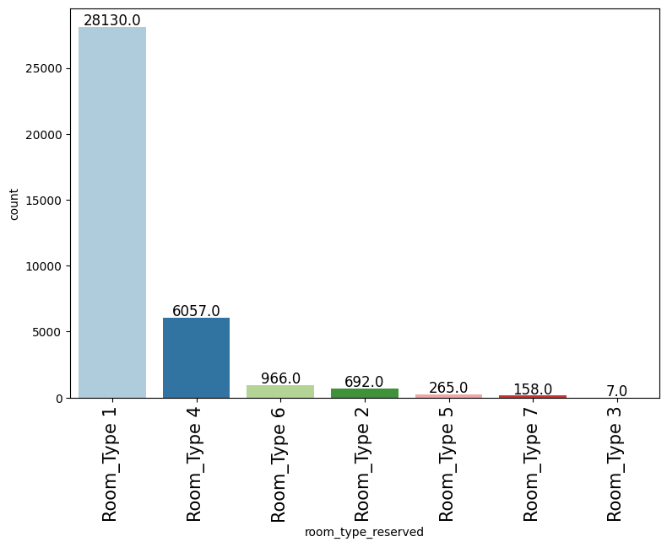
EDA Results: Univariate Analysis: Room Type Reserved
78% of the bookings registered Room Type 1
Close to 0% registered Room Type 3
Link to Appendix slide on data background check

Slide 20
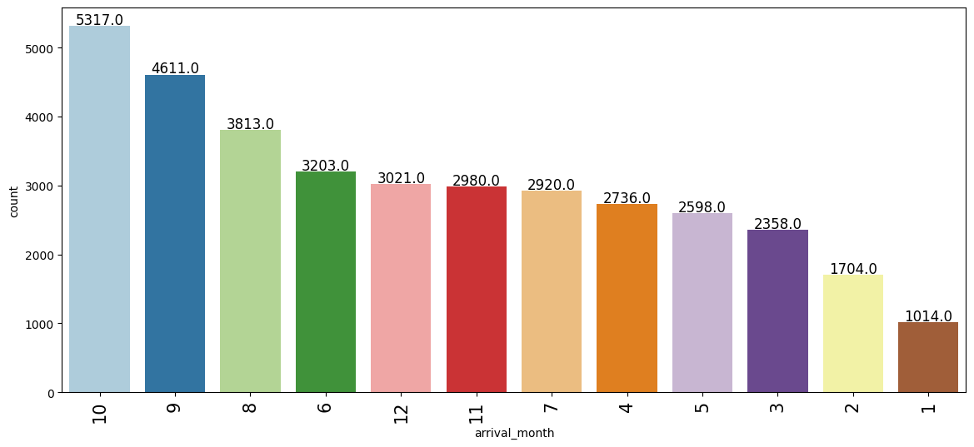
EDA Results: Univariate Analysis: Arrival Month
Most frequently registered arrival month is October (15%)
The least frequently registered month is January (3%)
Link to Appendix slide on data background check

Slide 21
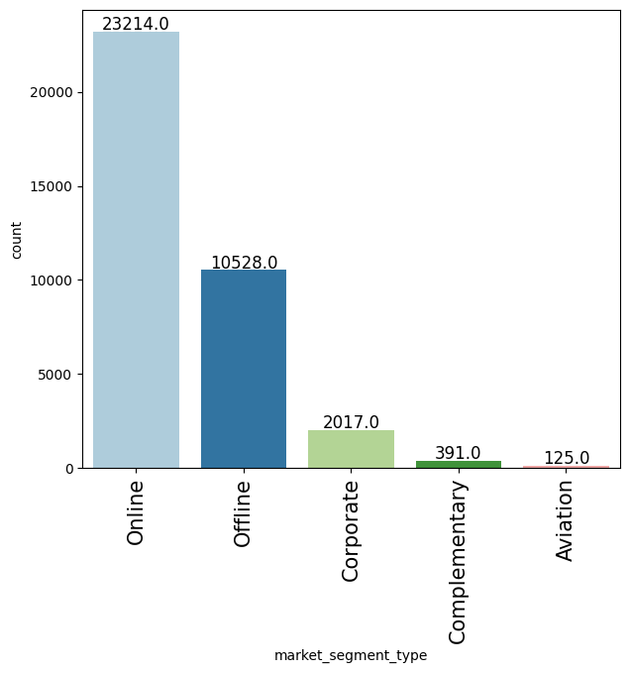
EDA Results: Univariate Analysis: Market Segment Type
64% of the bookings were registered from the online market segment
The least number of bookings were registered from the aviation market segment (0.3%)
Link to Appendix slide on data background check

Slide 22
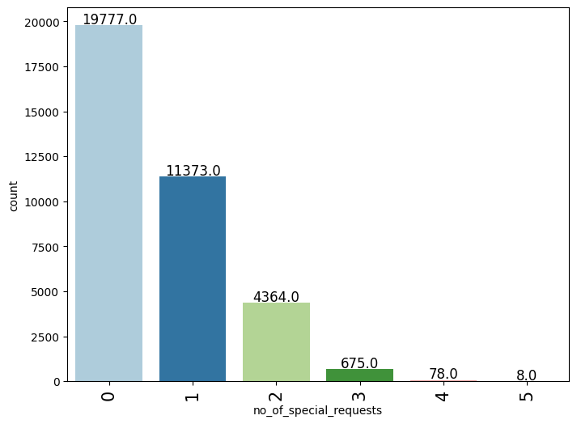
EDA Results: Univariate Analysis: Number of Special Requests
54% of the bookings came from clients who made no special requests
31% made 1 special request and 0.2% made 4 to 5 special requests
Link to Appendix slide on data background check

Slide 23
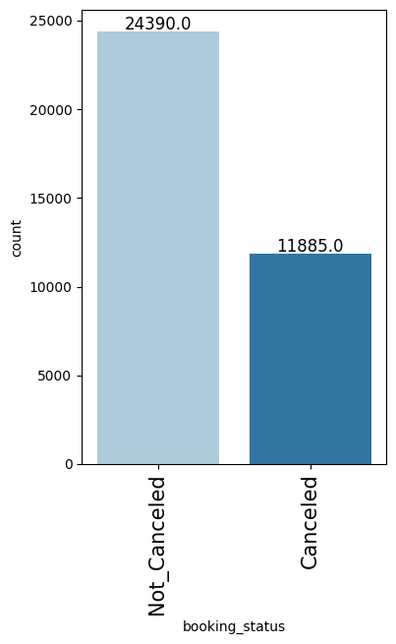
EDA Results: Univariate Analysis: Booking Status
67% of the bookings were not cancelled
Link to Appendix slide on data background check

Slide 24
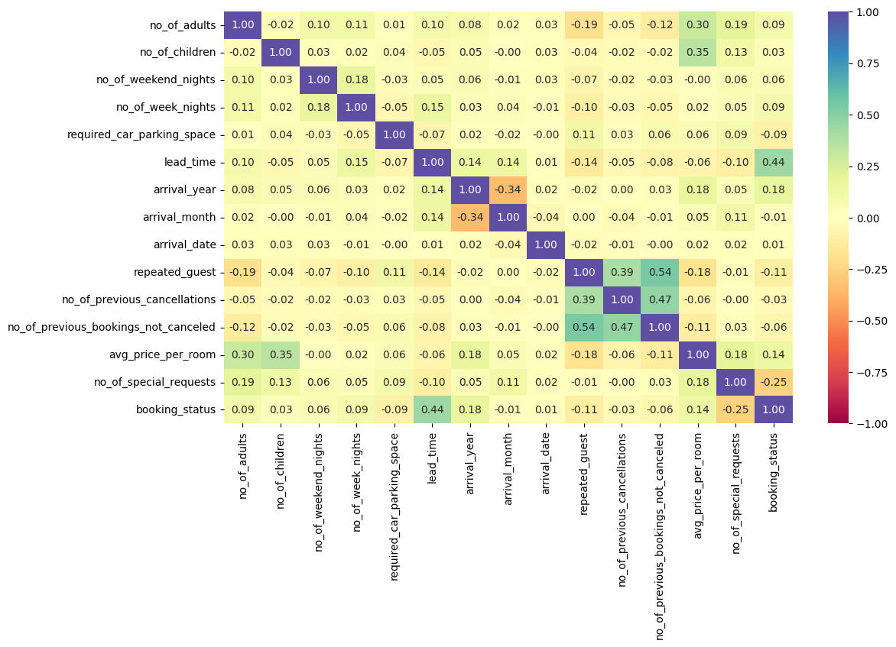
EDA Results: Bivariate Analysis: Correlation (Heatmap)
The most significant correlation (0.54) registered is between the repeated guest status and the number of previous bookings not cancelled
The booking status is most correlated (0.44) with the lead time, suggesting that there is a higher probability that a booking is cancelled for greater lead times
Link to Appendix slide on data background check

Slide 25
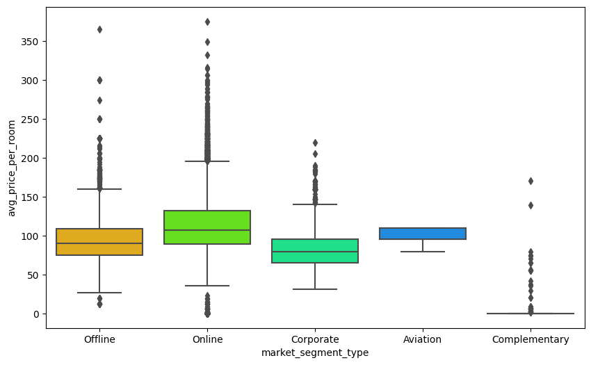
EDA Results: Bivariate Analysis: Average Price Per Room vs Market Segment Type
The online market segment registered the most varied and tended to register the greatest average price per room
The complementary market segment registered the least varied and tended to register the least average price per room
Link to Appendix slide on data background check

Slide 26
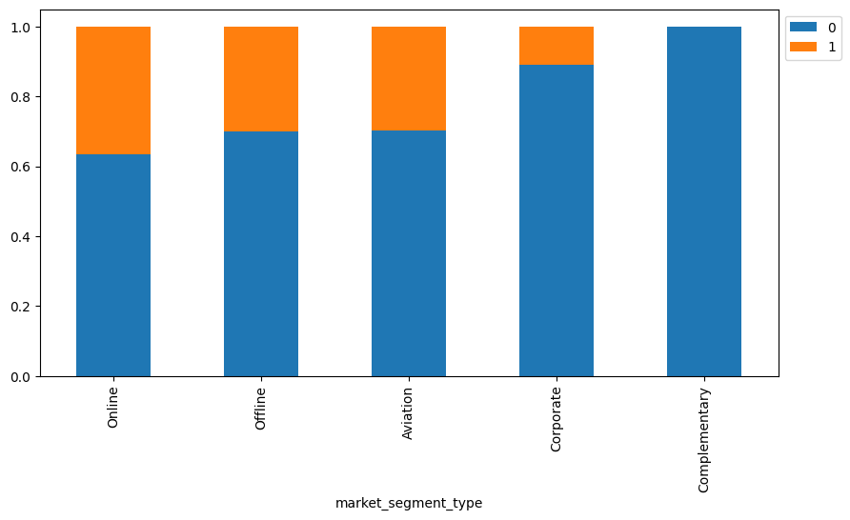
EDA Results: Bivariate Analysis: Booking Status vs Market Segment Type
The online market segment registered the greatest percentage of cancellations meanwhile the complementary market segment had no cancellations
Link to Appendix slide on data background check

Slide 27
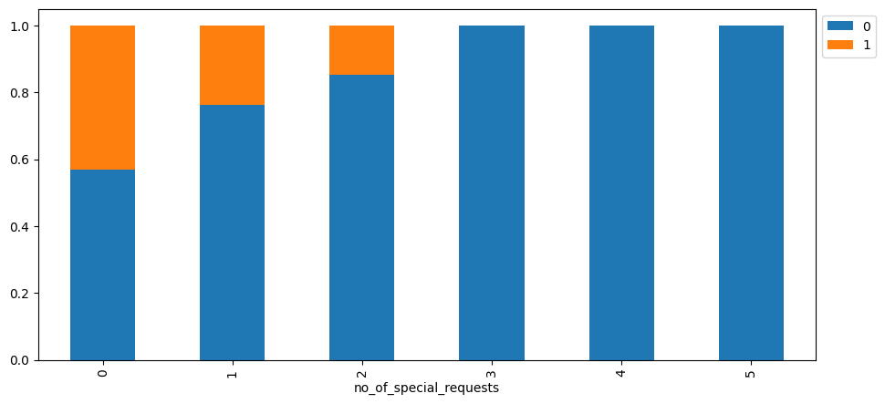
EDA Results: Bivariate Analysis: Booking Status vs Number of Special Requests
The greatest percentage of cancellations was registered for bookings with no associated special requests whereas no cancellations were made for bookings with more than 2 special requests
Link to Appendix slide on data background check

Slide 28
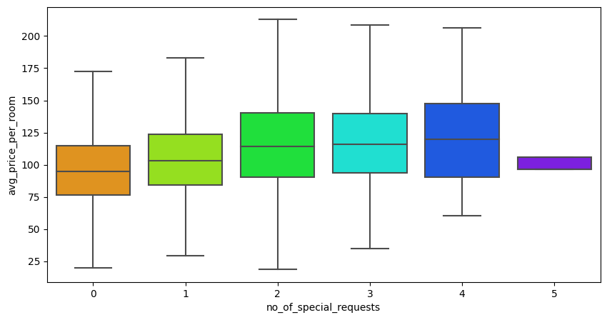
EDA Results: Bivariate Analysis: Average Price Per Room vs Number of Special Requests
Bookings with 4 special requests tended to have the highest and most varied average price per room
Bookings with 5 special requests had the least varied and, together with bookings having no special request, tended to have the least average price per room
Link to Appendix slide on data background check

Slide 29
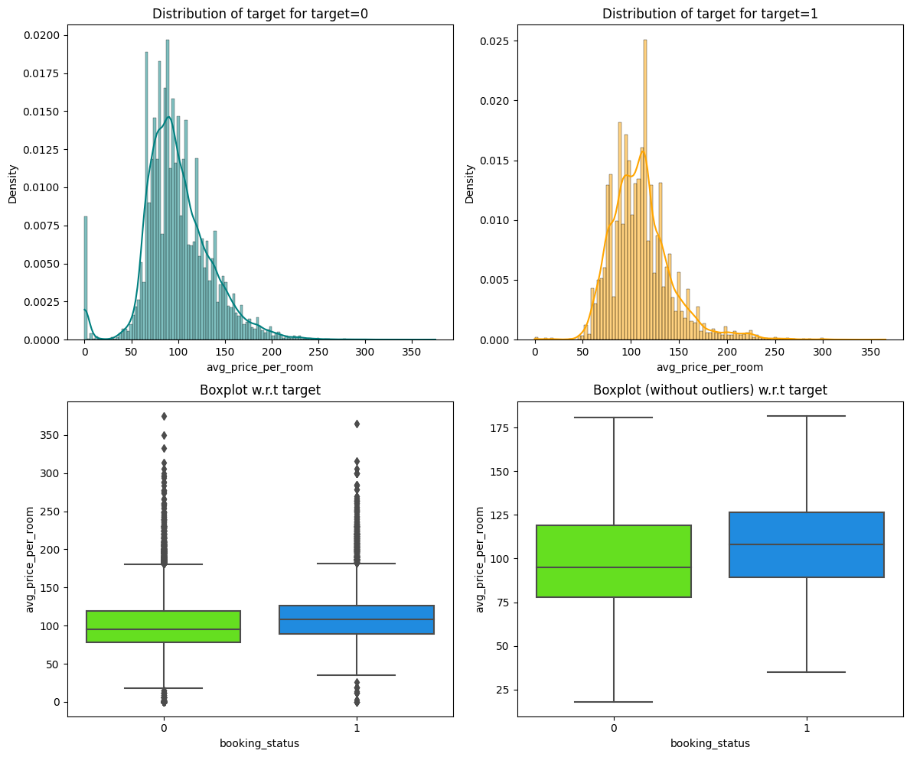
EDA Results: Bivariate Analysis: Average Price Per Room vs Booking Status
The average price per room is right skewed for both cancelled and not cancelled bookings
The average price per room tends to be about 15 euros higher for cancelled than not cancelled bookings
Link to Appendix slide on data background check

Slide 30
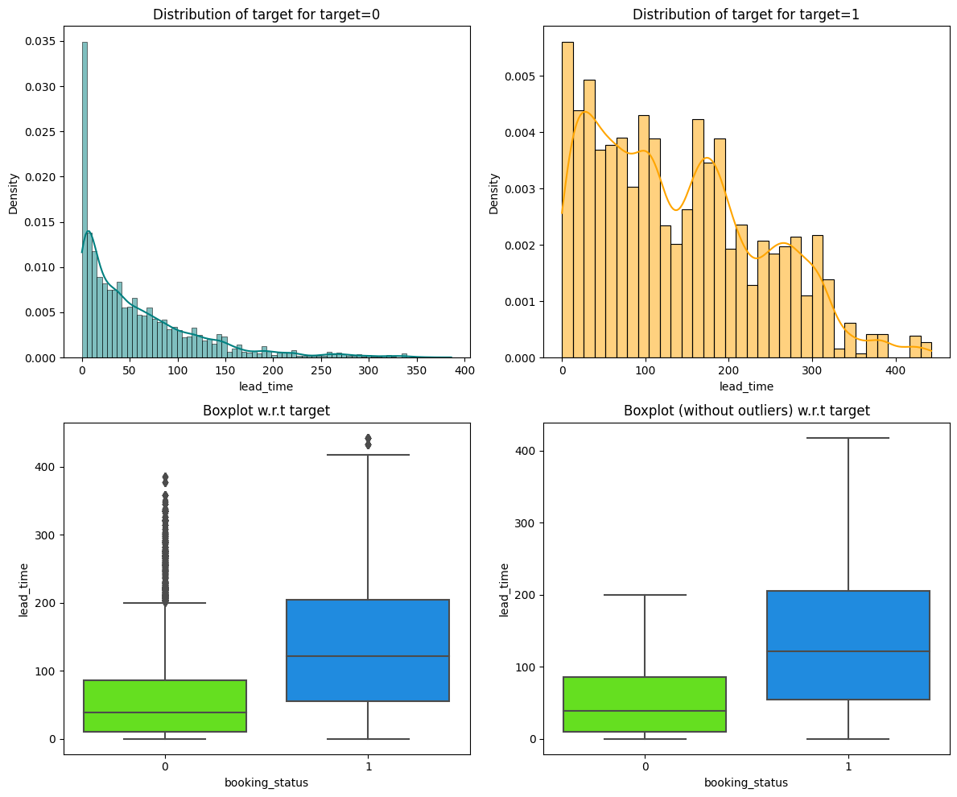
EDA Results: Bivariate Analysis: Lead Time vs Booking Status
The lead time of both cancelled and not cancelled bookings is right-skewed
The lead time tends to be about 70 days longer and is significantly more varied for cancelled than not cancelled bookings
Link to Appendix slide on data background check

Slide 31
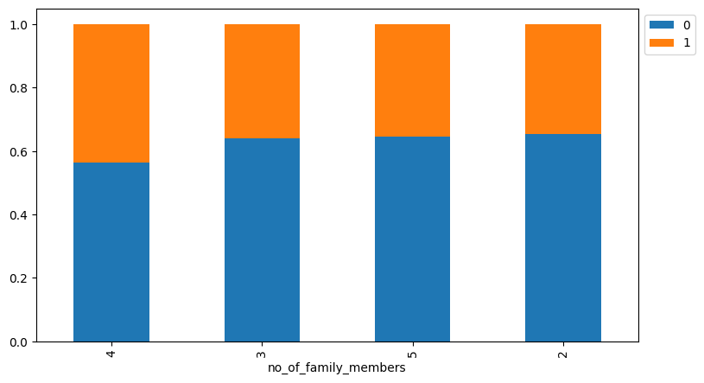
EDA Results: Bivariate Analysis: Number of Family Members vs Booking Status
The greatest percentage of cancellations were registered for bookings with 4 family members
Bookings registering 3, 5, and 2 family members had approximately the same percentage of cancellation
Link to Appendix slide on data background check

Slide 32
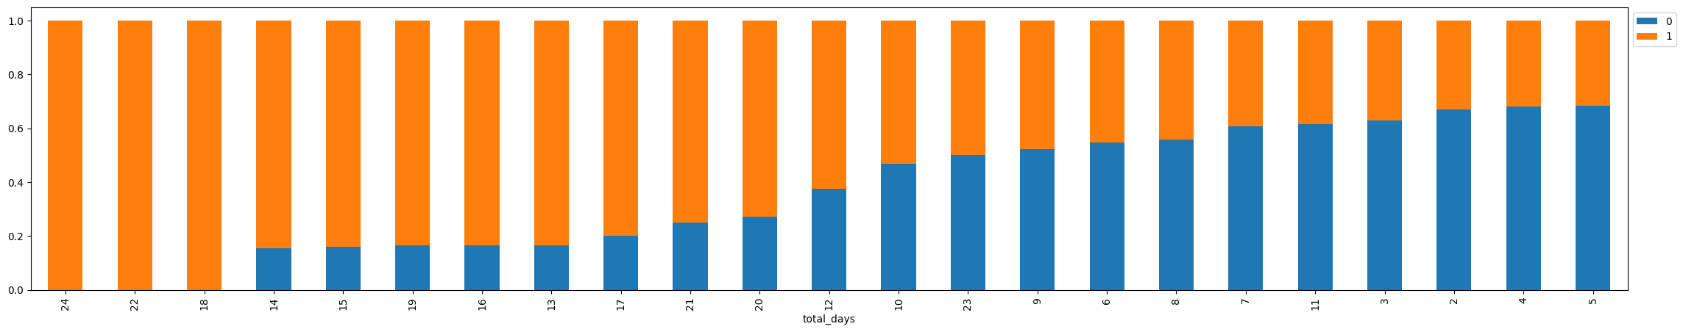
EDA Results: Bivariate Analysis: Total Days vs Booking Status
For bookings registering both week and weekend nights, clients who booked 18, 22, and 24 days cancelled their bookings
For bookings registering both week and weekend nights, bookings for 2, 4, and 5 days registered the least percentage of cancellations
Link to Appendix slide on data background check

Slide 33
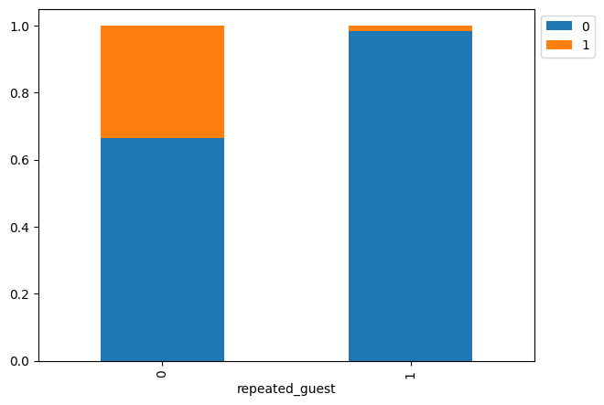
EDA Results: Bivariate Analysis: Repeated Guests vs Booking Status
New clients are much more likely to cancel their bookings
Old clients almost never cancel
Link to Appendix slide on data background check

Slide 34
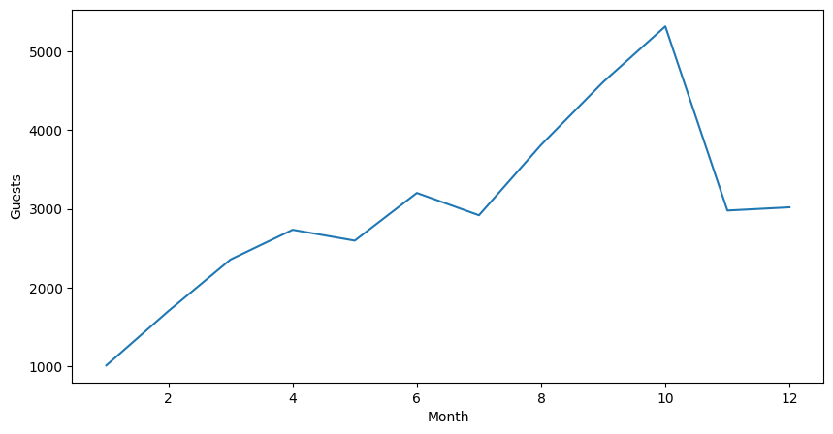
EDA Results: Bivariate Analysis: Month vs Guests
We have confirmation that October registered the greatest number of arrivals whereas January had the least
Link to Appendix slide on data background check

Slide 35
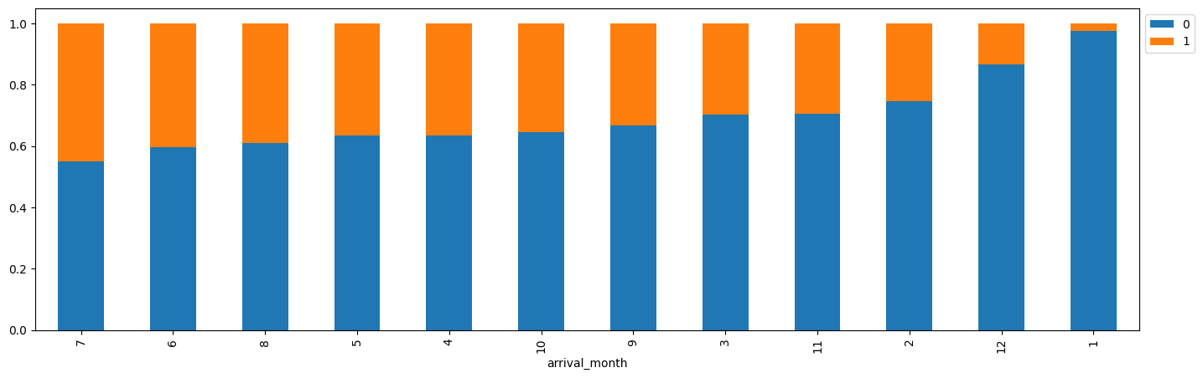
EDA Results: Bivariate Analysis: Arrival Month vs Booking Status
The greatest percentage of cancellations was registered for bookings by clients arriving in July and the least for those arriving in January
Link to Appendix slide on data background check

Slide 36
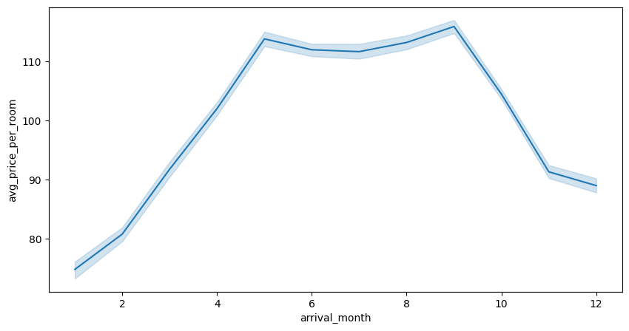
EDA Results: Bivariate Analysis: Arrival Month vs Average Price Per Room
The most expensive bookings were registered for arrivals between May and September; correlates with trend of arrivals - demand was clearly highest during summer
Link to Appendix slide on data background check

Slide 37
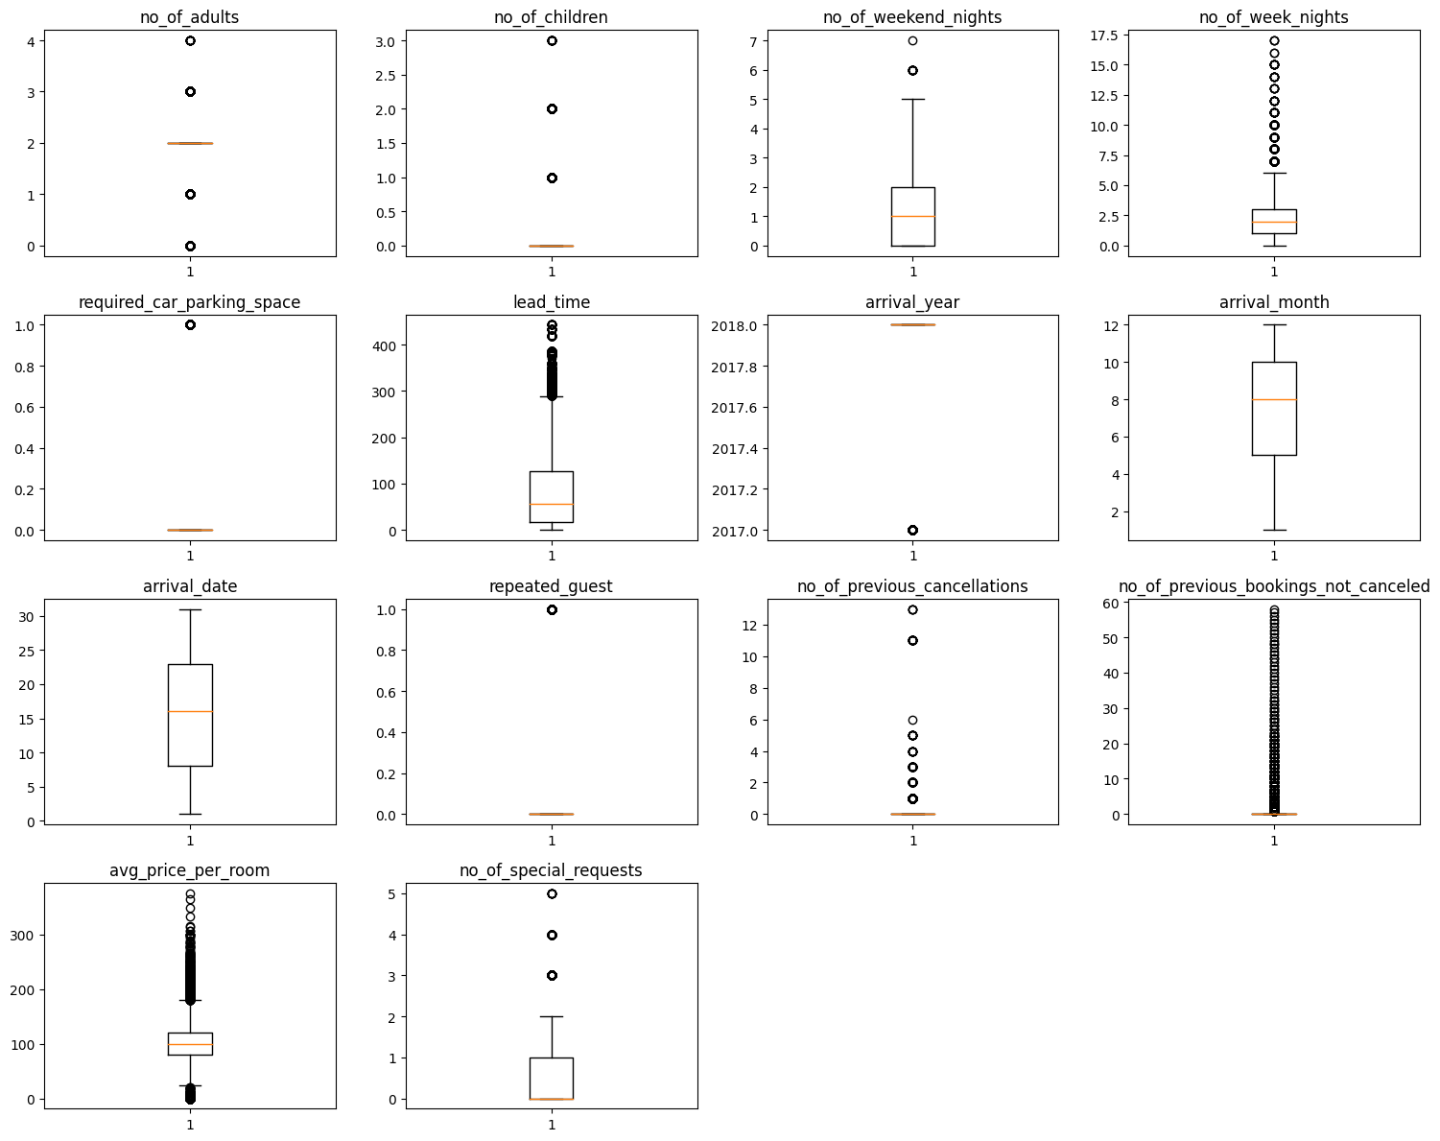
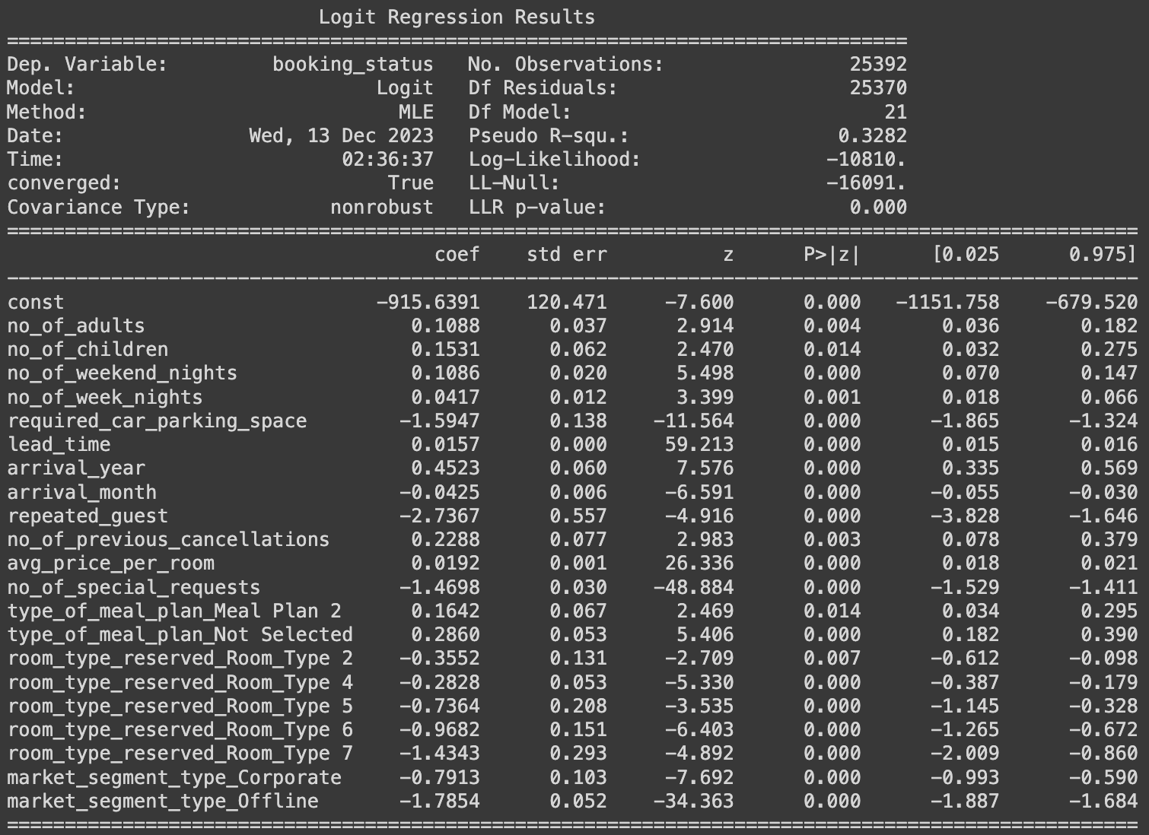
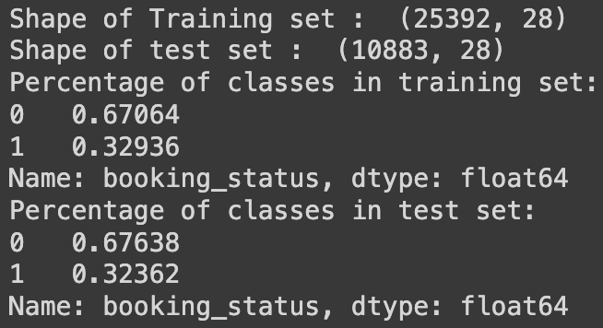
Data Preprocessing
The dataset contains no duplicates and no missing values
Most of the attributes are right-skewed
The arrival year is left-skewed
The number of adults has roughly equal upper and lower outliers
The arrival month and arrival date have no outliers
A special form of winsorization has been used to handle outliers of the average price per room: Values greater than 500 have been assigned the value of the upper whisker, which is about 180
Both the logistic and tree models benefitted of similar encoding:
Splitting the data into predictor and target variables
Encoding the target variable (Booking Status): 1 for cancellation and 0 for non-cancellation
Dummy transformation of categorical predictor variables
Adding a constant to the predictor variables solely for the logistic regression model
Finally splitting the transformed variables into training and rest data respectively in the ratio 7:3
The class distribution in the training and test data set is approximately the same (1 cancellation to 2 non-cancellations), confirming our previous observation that about 2/3 of the bookings were not cancelled
None of the non-dummy variables has a variance inflation factor greater than 5; so we can conclude that no multicollinearity exists among the predictor variables
After excluding relatively insignificant (high p-value) variables, the performance of the logistic model remains practically the same on the training data set: 81% accuracy, 63% recall, 74% precision, and 68% F1 score

Slide 38
Data Preprocessing
Duplicate value check
Missing value treatment
Outlier check (treatment if needed)
Feature engineering
Data preparation for modeling
Note: You can use more than one slide if needed

Slide 39
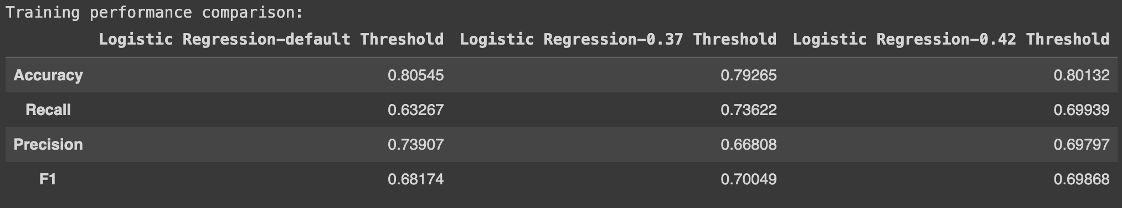
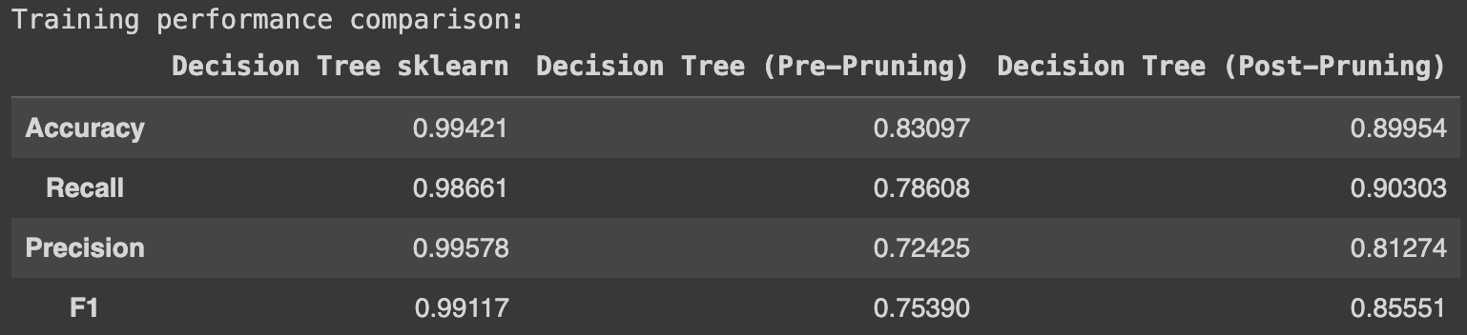
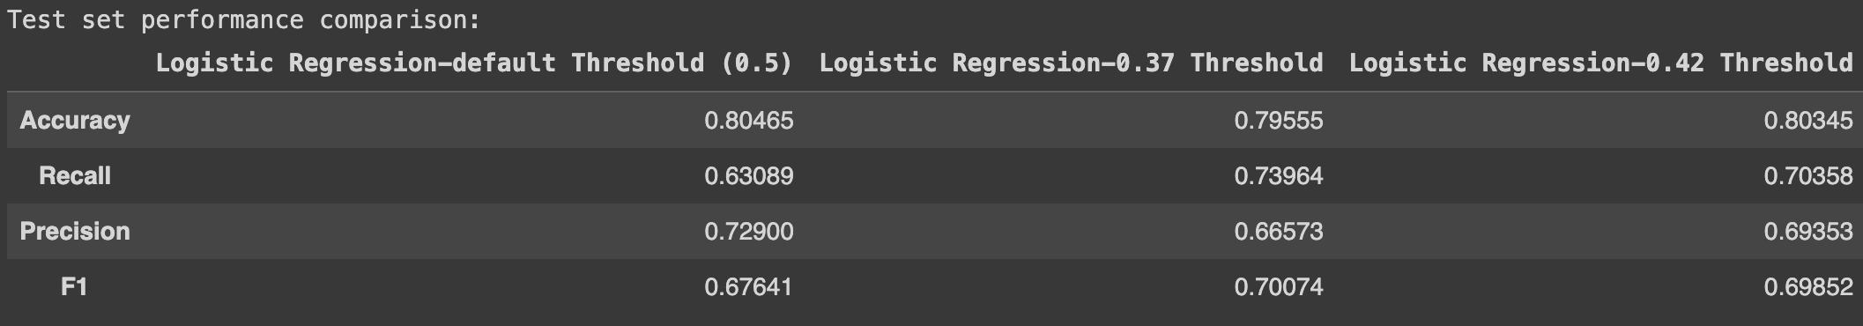
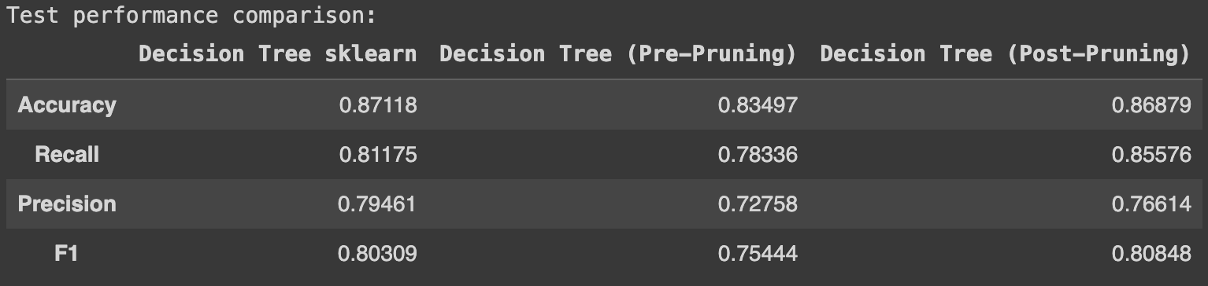
Model Performance Summary
Training Performance - Logit
Training Performance - Tree
The performance of the logistic model on the training data set for the three thresholds is as follows:
Accuracy is highest for the default threshold and lowest for the threshold of 37%
The F1 score is highest for the threshold of 37% and least for default threshold
The performance of the logistic model on the test data set for the three thresholds is as follows:
Accuracy is highest for model with the default threshold and lowest for the model with a threshold of 0.37
The F1 score is highest for the model with a threshold of 0.37 and lowest for the model with the default threshold
The performance of the untuned, pre-tuned, and post-tuned tree classifier models on the training data is as follows:
Both the accuracy and f1 score are highest for the untuned model and lowest for the pre-tuned model
The performance of the untuned, pre-tuned, and post-tuned tree classifier models on the test data is as follows:
The accuracy is highest for the untuned model and lowest for the pre-tuned model
The f1 score is highest for the post-tuned model and lowest for the pre-tuned model
Test Performance - Logit
Test Performance - Tree

Slide 40
APPENDIX

Slide 41
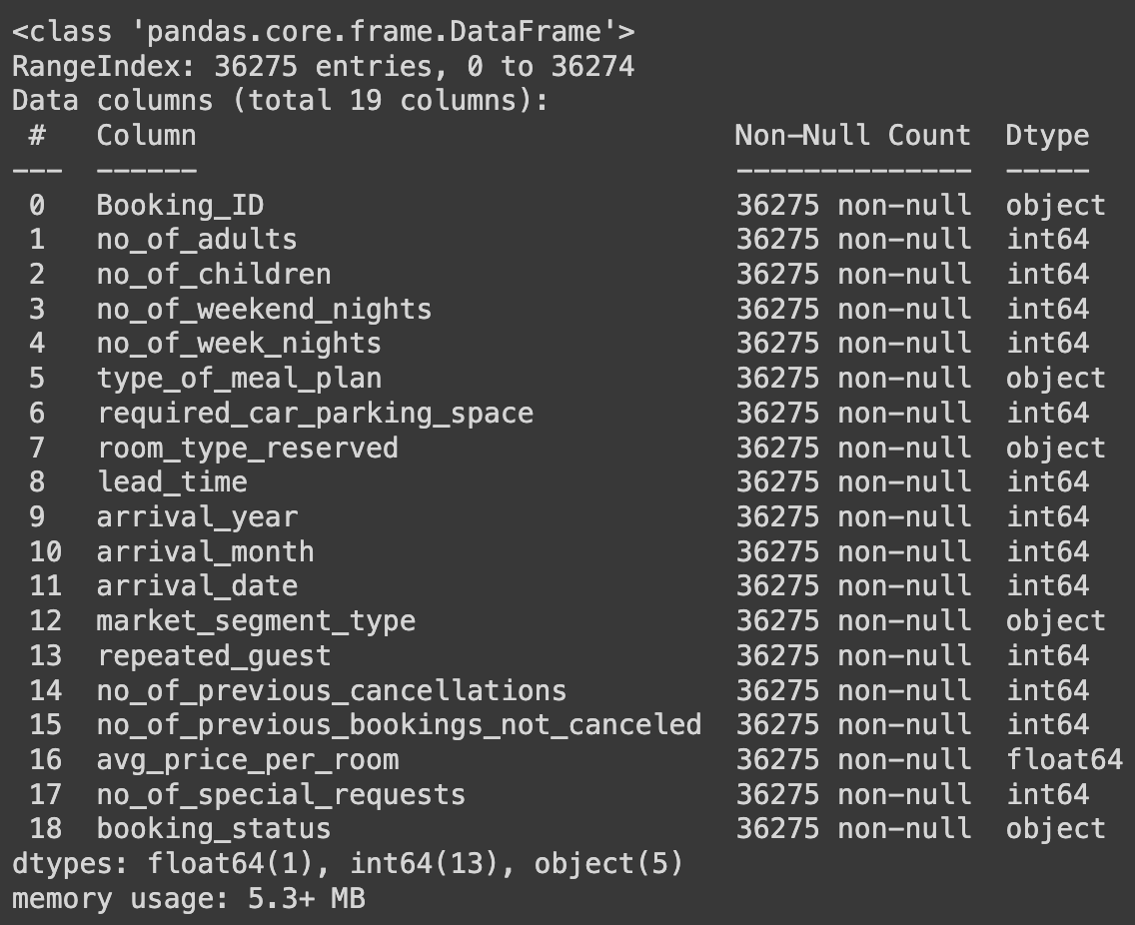
Data Background and Contents
The data has 5 categorical columns including Booking_ID which will be dropped because it has distinct values for each row and is simply used for identification
The dataset has 19 columns (attributes) and 36275 rows (records)
The dataset has 5 categorical columns and 14 numerical columns (13 int and 1 float); the categorical columns need to be encoded before running any model on the data
The target column/variable (booking_status) is categorical and needs to be encoded before running any model on the data

Slide 42
Model Building - Logistic Regression
The two principal verifications carried out to validate the use of logistic regression are multicollinearity and significance of each parameter assessed respectively by evaluation of the respective variance inflation factors and p-values
The initial logistic model performance without parameter tuning registered an accuracy of 81%, recall of 63%, precision of 74%, and F1 score of 68% on the training set
None of the non-dummy variables has a variance inflation factor greater than 5; so we can conclude that no multicolinearity exists among the predictor variables
After excluding relatively insignificant (high p-value) variables, the performance of the logistic model remains practically the same on the training data set: 81% accuracy, 63% recall, 74% precision, and 68% F1 score
For the logistic model trained on significant parameters, all else respectively held constant, an increase of one adult, child, required car parking space, arrival year, number of previous cancellations, average price per room, and number of special requests will result in corresponding 11% increase, 17% increase, 80% decrease, 57% increase, 26% increase, 2% increase, and 77% decrease of the odds of the booking being cancelled
For the logistic model trained on significant parameters, the odds of an old client cancelling his/her booking is 94% less than that of a new client

Slide 43
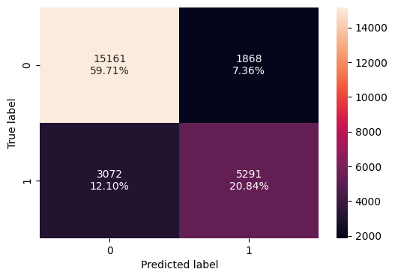

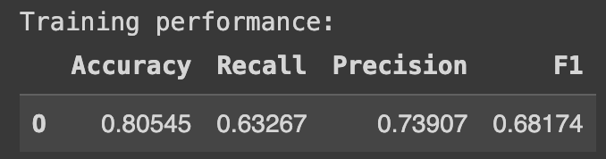
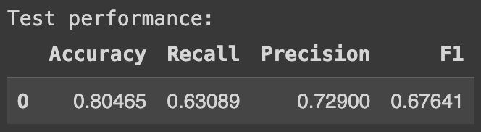
Model Performance Evaluation and Improvement - Logistic Regression: Default Threshold
Training Performance
Test Performance
Performance of the logistic model with the default threshold on the training data set:
60% TN, 7% FP, 12% FN, and 21% TP
81% accuracy, 63% recall, 74% precision, and 68% F1 score
Performance of the logistic model with the default threshold on the test data set:
60% TN, 8% FP, 12% FN, and 20% TP
80% accuracy, 63% recall, 73% precision, and 68% f1 score

Slide 44
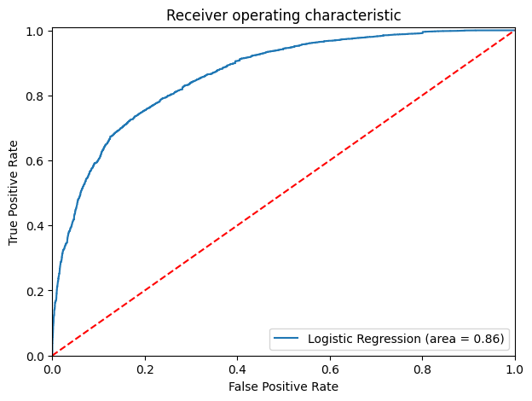
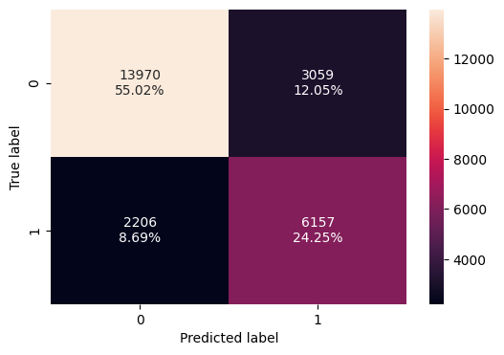
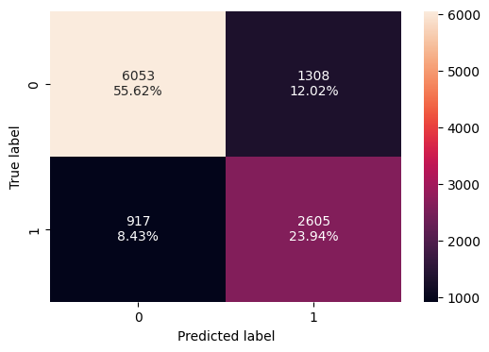
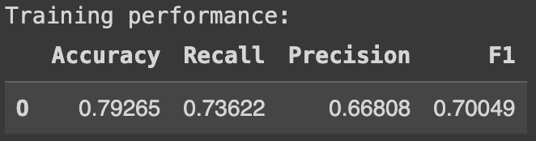
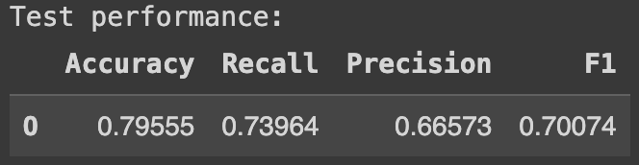
Model Performance Evaluation and Improvement - Logistic Regression: Optimal AUC-ROC Threshold (0.37)
Training Performance
Test Performance
Performance of the logistic model with optimal auc-roc threshold on the training data set:
55% TN, 12% FP, 9% FN, and 24% TP
79% accuracy, 74% recall, 67% precision, and 70% F1 score
Performance of the logistic model with optimal auc-roc threshold on the test data set:
56% TN, 12% FP, 8% FN, and 24% TP
80% accuracy, 74% recall, 67% precision, and 70% f1 score

Slide 45
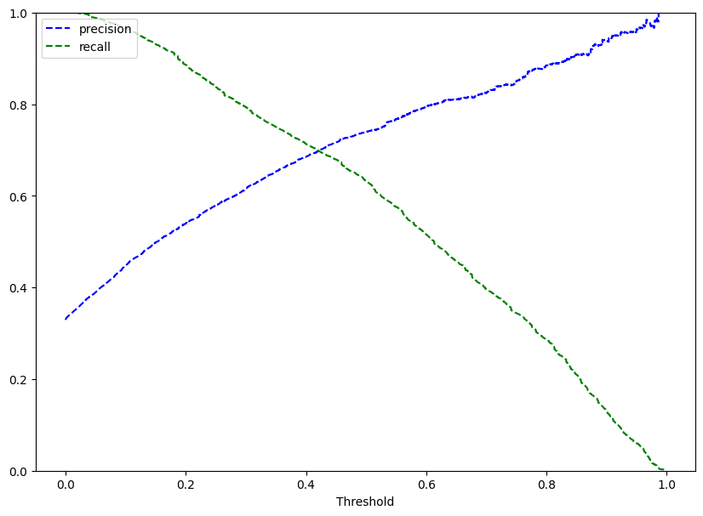

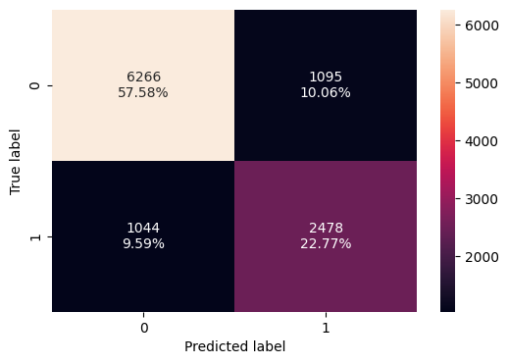
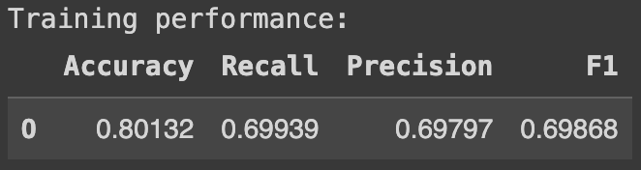
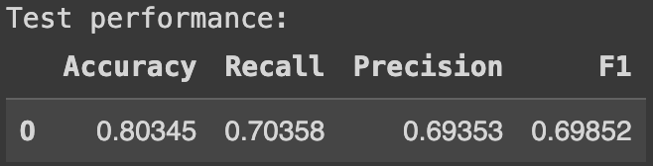
Model Performance Evaluation and Improvement - Logistic Regression: Optimal Precision-Recall Threshold (0.42)
Training Performance
Test Performance
Performance of the logistic model with optimal precision-recall threshold on the training data set:
57% TN, 10% FP, 10% FN, and 23% TP
80% accuracy, 70% recall, 70% precision, and 70% F1 score
Performance of the logistic model with optimal precision-recall threshold on the test data set:
58% TN, 10% FP, 10% FN, and 23% TP
80% accuracy, 70% recall, 69% precision, and 70% f1 score

Slide 46
Model Building - Decision Tree
Just as in the case of logistic regression, we will encode both the prediction and target variables, transforming categorical variables into dummy variables and splitting the data into training and test data sets in a ratio of 7:3 (No need adding a constant to the predictor variables since the target model is non-linear)
We will then build the Decision Tree Classifier model, fitting it to the train data (one advantage of the tree classifier model is the relatively limited feature engineering required before building the model)
The model registered varying performance for the training and test sets and depending on whether hyper-parameters were untuned, pre-tuned, or post-tuned

Slide 47
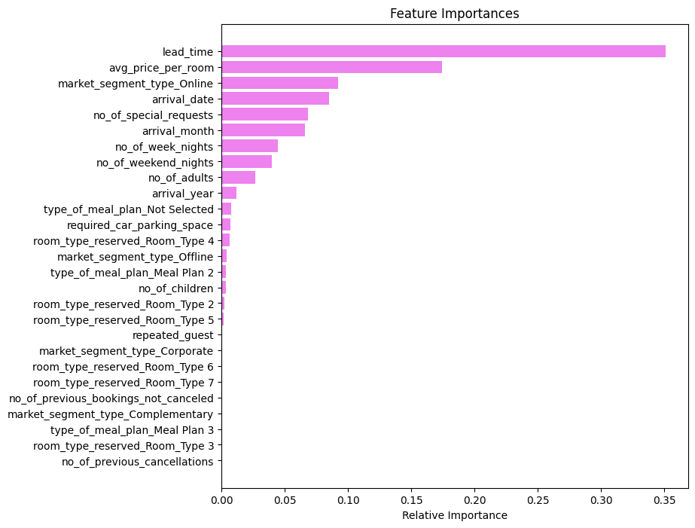




Model Performance Evaluation and Improvement - Decision Tree: Untuned Hyperparameters
Training Performance
Test Performance
Performance of the tree classifier model with untuned hyperparameters on the training data set:
67% TN, 0.1% FP, 0.4% FN, and 32% TP
99% accuracy, 99% recall, 100% precision, and 99% f1 score
Performance of the tree classifier model with untuned hyperparameters on the test data set:
61% TN, 7% FP, 6% FN, and 26% TP
87% accuracy, 81% recall, 79% precision, and 80% f1 score
The lead time is the most important feature of the tree classifier model followed by the average price per room

Slide 48






Model Performance Evaluation and Improvement - Decision Tree: Pre-Tuned Hyperparameters
Training Performance
Test Performance
The pre-tuned tree classifier model uses the following hyperparameters: balanced class weight, max depth of 6, max leaf nodes of 50, and minimum samples per split of 10
Performance of the tree classifier model with pre-tuned hyperparameters on the training data set:
57% TN, 10% FP, 7% FN, and 26% TP
83% accuracy,79% recall, 72% precision, and 75% f1 score
Performance of the tree classifier model with pre-tuned hyperparameters on the test data set:
58% TN, 9% FP, 7% FN, and 25% TP
83% accuracy, 78% recall, 73% precision, and 75% f1 score
The lead time is the most important feature of the pre-tuned tree classifier model followed by the online market segment type

Slide 49









Model Performance Evaluation and Improvement - Decision Tree: Post-Tuned Hyperparameters
Training Performance
Test Performance
The total impurity of leaves increases with increase in the effective alpha but the relationship is non-linear
The number of nodes and depth of tree decreases with increase in alpha but the relationships are non-linear
The f1 score vs alpha curve is very similar for training and test data
The best (highest f1 score for test data) post-tuned tree classifier model has an alpha value of 0.00012 and the class weight is balanced
Performance of the tree classifier model with post-tuned hyperparameters on the training data set:
60% TN, 7% FP, 3% FN, and 30% TP
90% accuracy,90% recall, 81% precision, and 86% f1 score
Performance of the tree classifier model with post-tuned hyperparameters on the test data set:
59% TN, 8% FP, 5% FN, and 28% TP
87% accuracy, 86% recall, 77% precision, and 81% f1 score
The lead time is the most important feature of the post-tuned tree classifier model followed by the online market segment type

